Slide 1
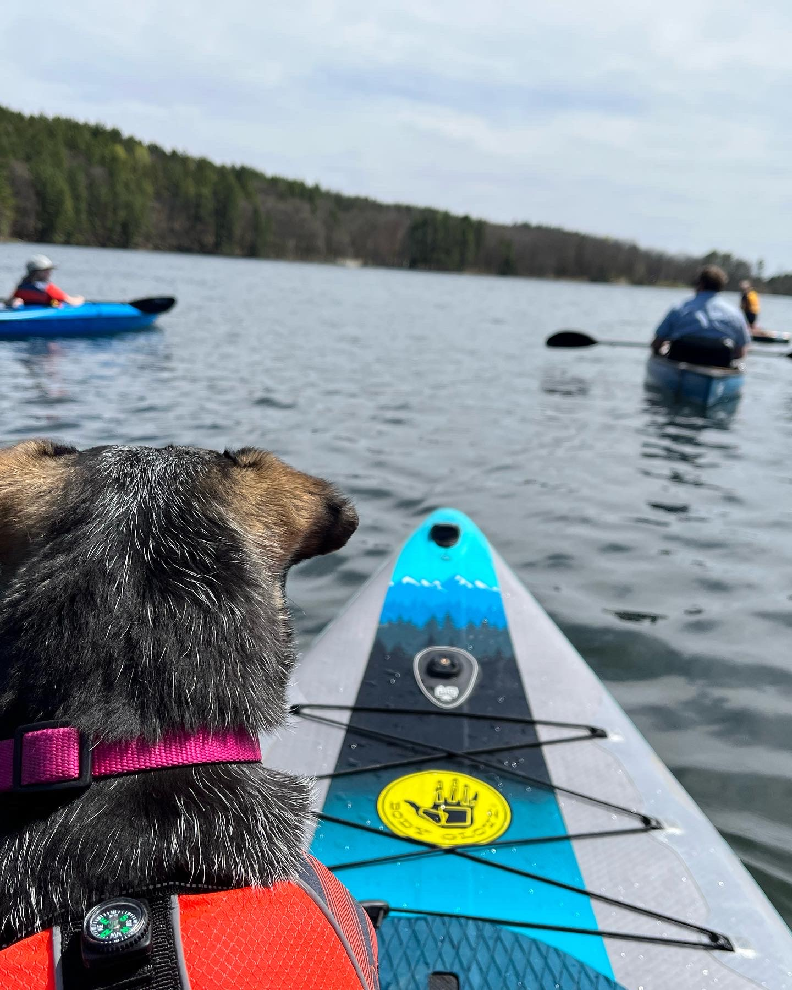
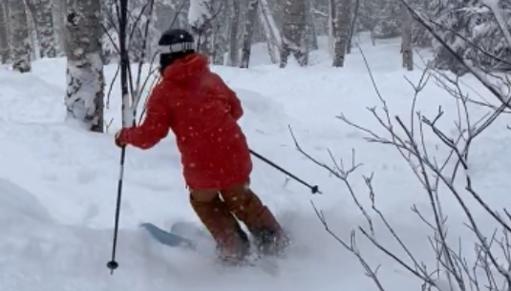
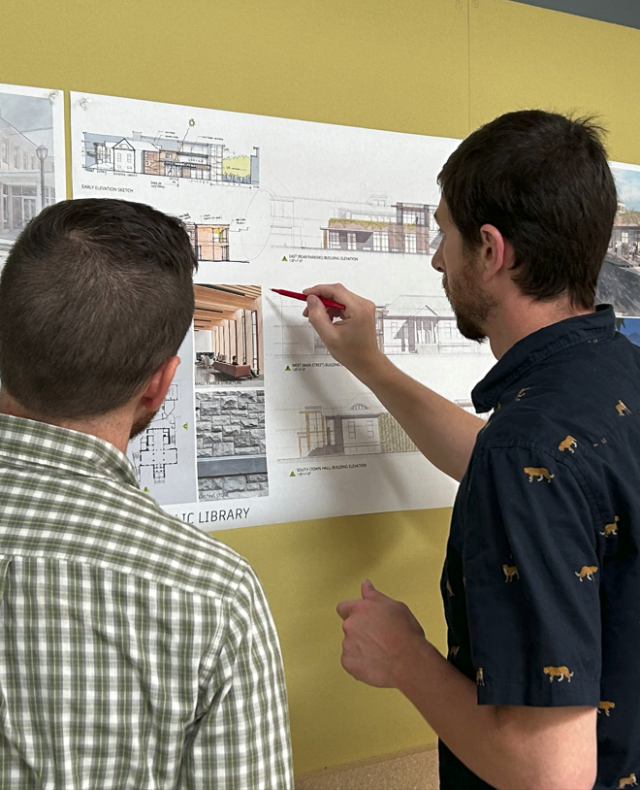
Looking for a rewarding career that’s in high demand in Vermont, helps define our communities, considers environmental impacts, and if no deadlines, helps you balance your life and work?
Life is good.
Be an Architect!
Learn more at www.aiavt.org

